Slide 1


Presentazione dati sondaggio

Slide 2
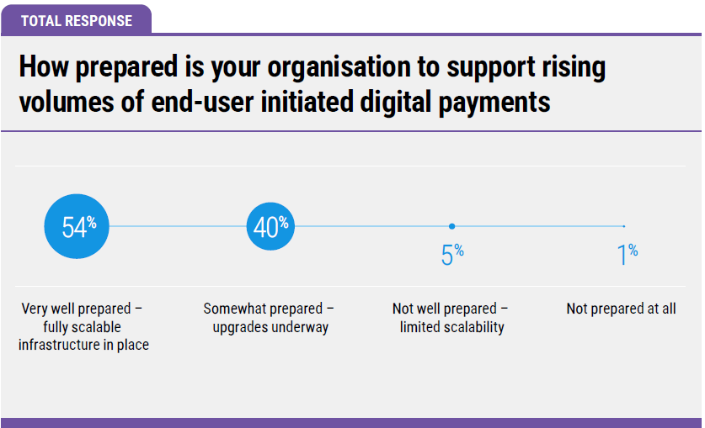
Assessing «digital readiness»
23,760
17,600
2,200
440
There are 44,000 banks and credit unions around the world.
https://www.extractable.com/insights/by-the-numbers-mega-banks-vs-community-banks/

Slide 3
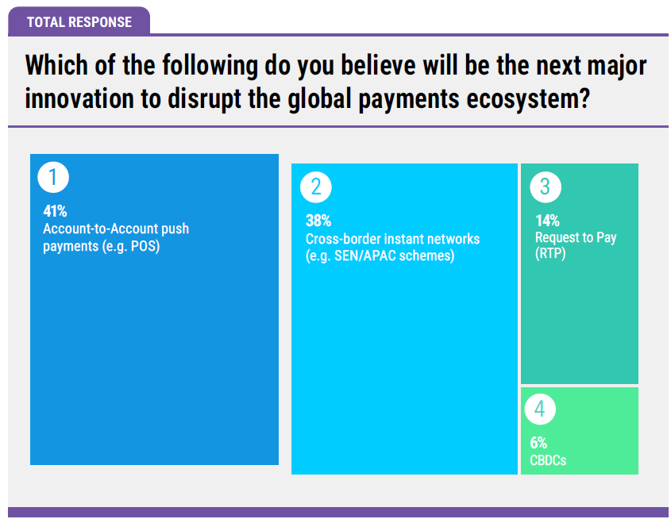
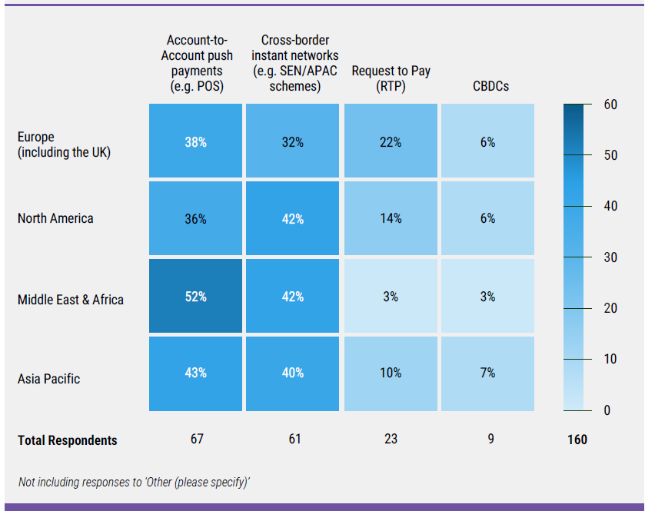
Your expectations

Slide 4
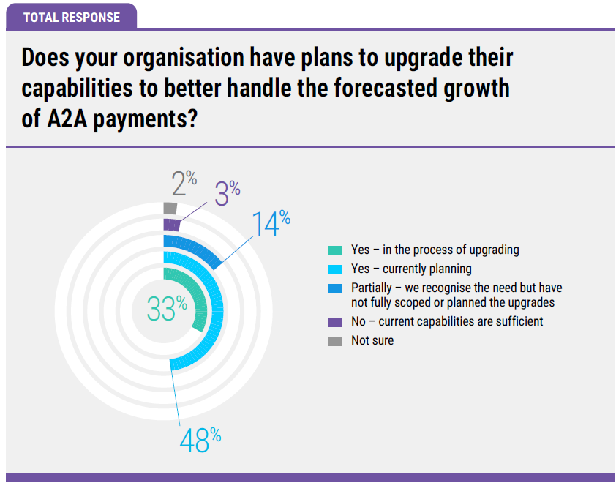
Recognizing the need of modernization
The momentum for modernization is strong (81%)
This highlights a clear industry recognition of what's at stake, forcing leaders to balance this forward-looking innovation with the non-negotiable demands of regulatory compliance

